Slide 1
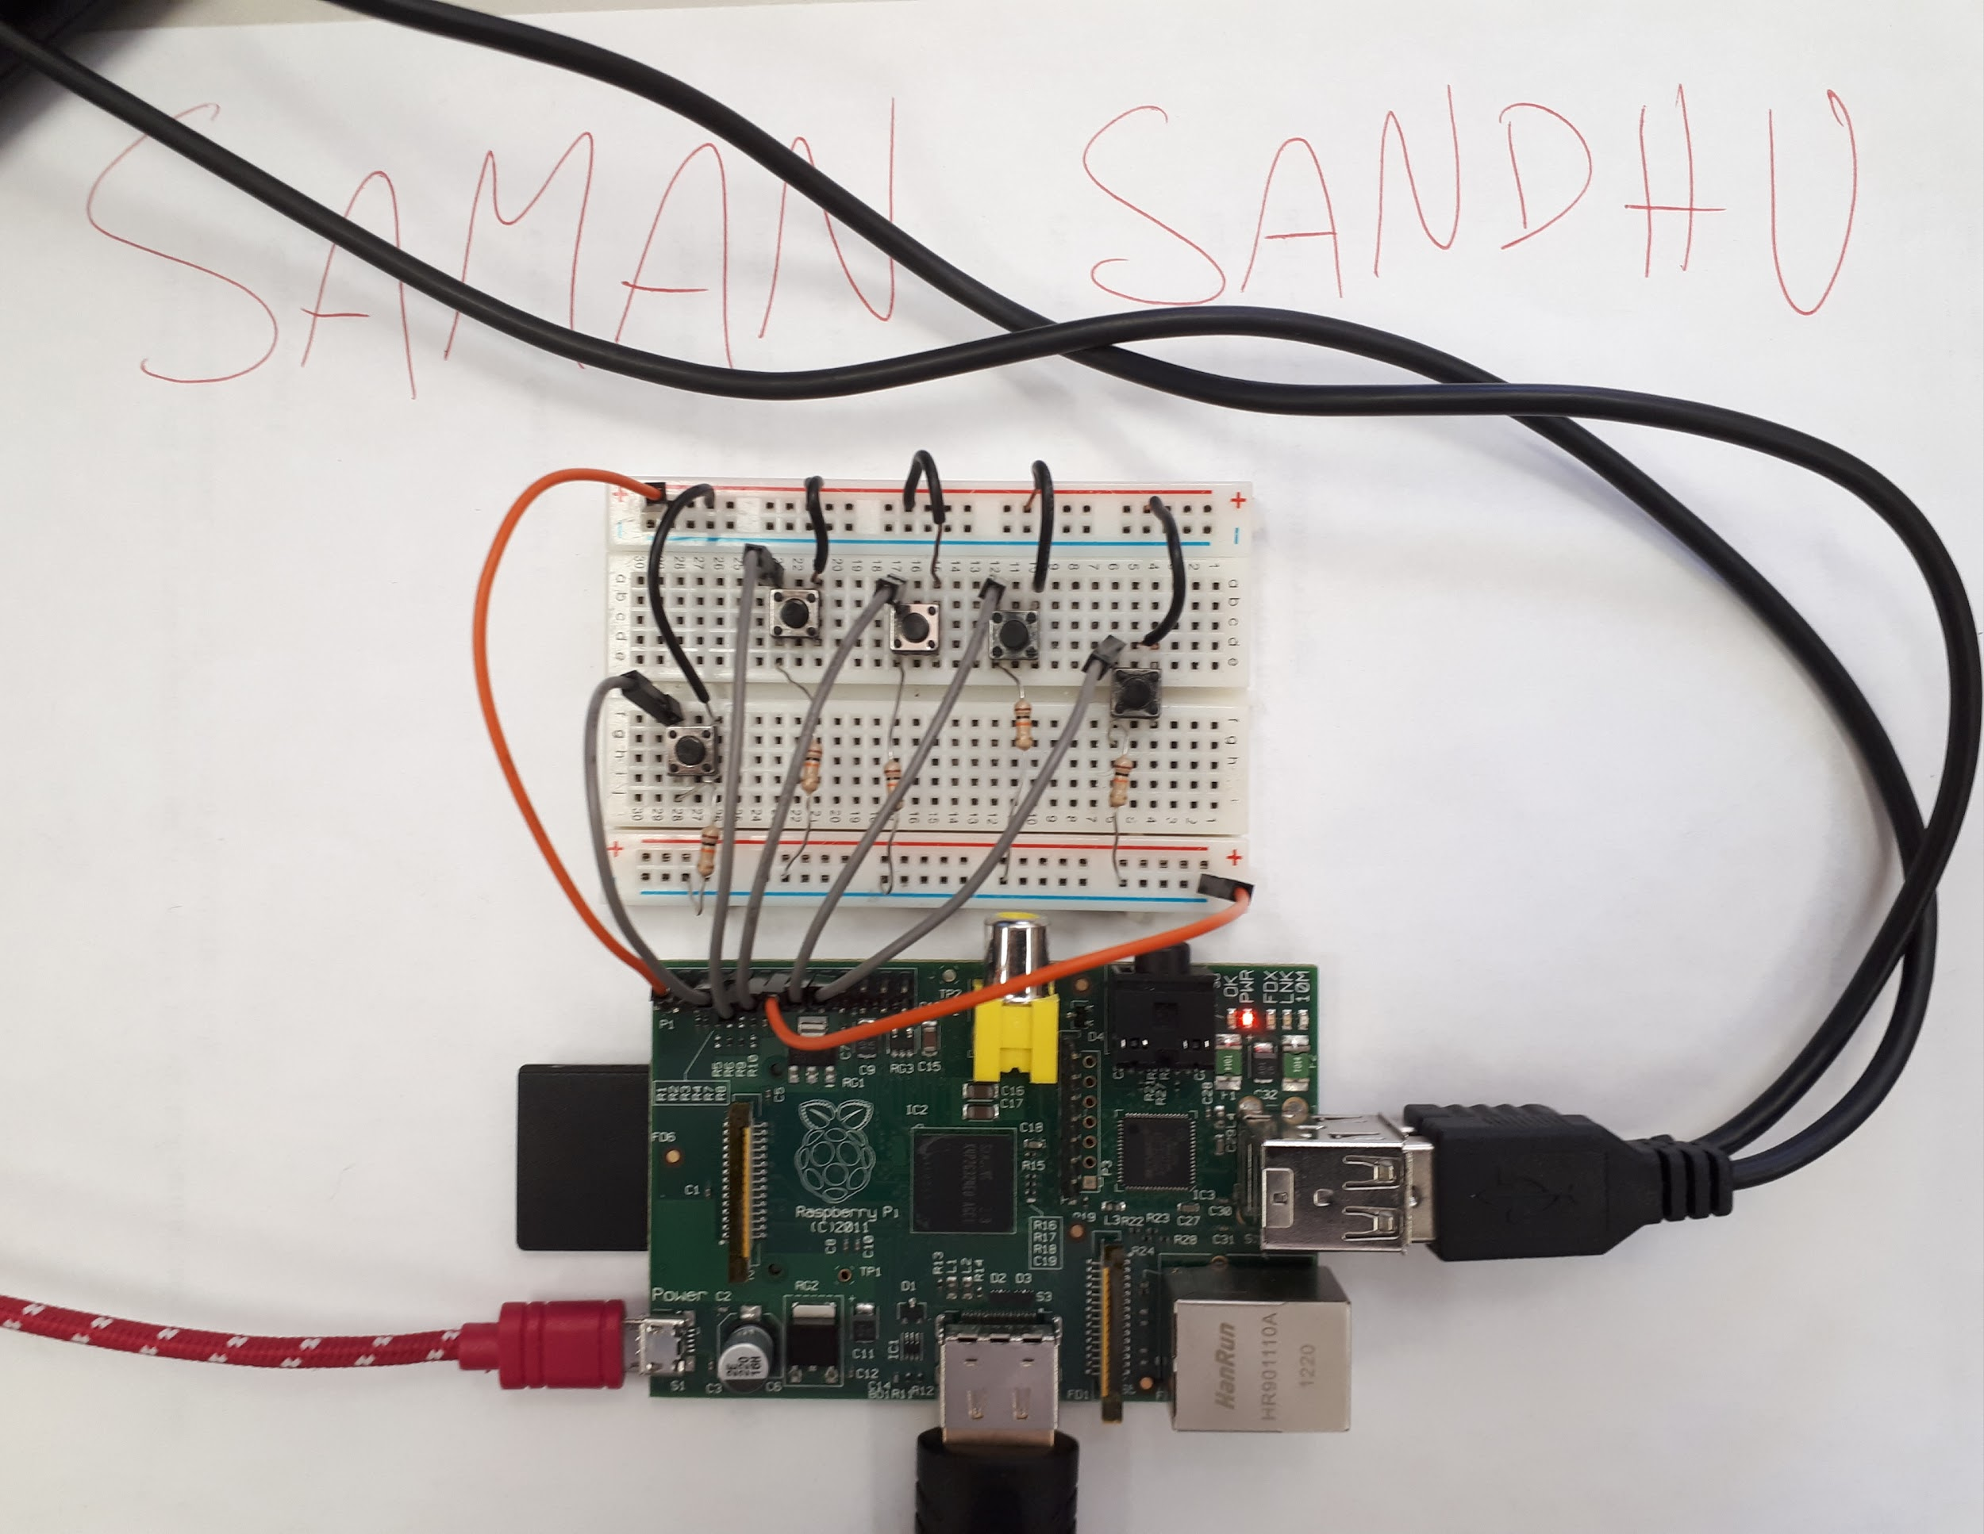
The Controller
Controller - raspberry pi as a game controller.
Buttons - The controller will have 5 buttons
2 of which are to control the depth of the submarine.
Another 2 will be used to pause and continue the game
The last button is used for the function of firing missiles.

Slide 2
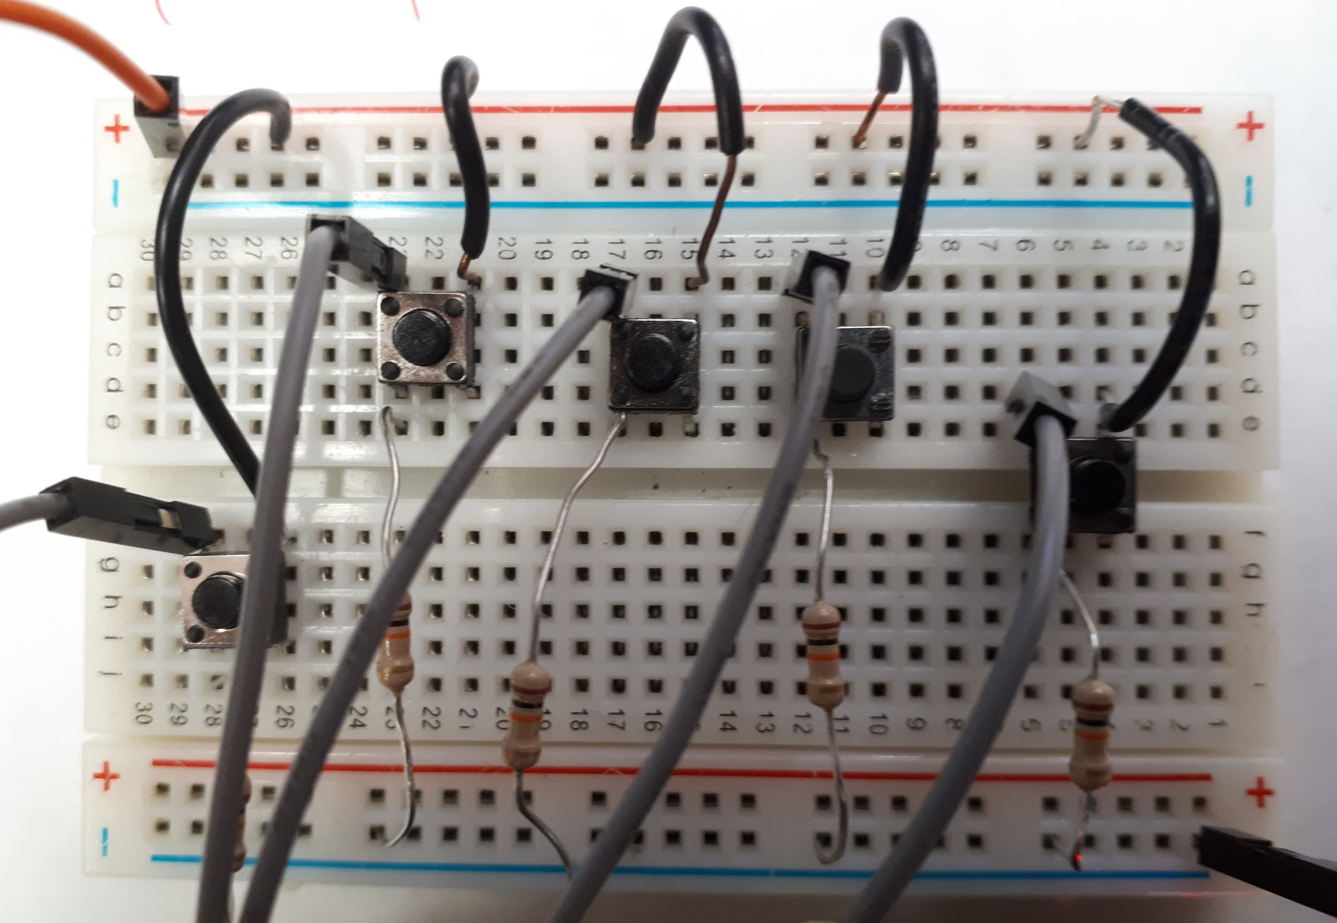
How to Play
As a player, if you get tired, you have the luxury of pressing pause and then continuing at a later time, by pressing the continue and pause button:
Due to pressure differences in the subpolar waters, the captain cannot exceed the parameters of the screen. In order to avoid death, the player must use the up and down buttons to increase or decrease in depth :
Since the captain of the submarine knew that the subpolar waters are full of Sharks and Whales, the captain equipped himself with multiple missiles, however there is a time interval between bursts of 5 missiles when no missiles can be fired. In order to fire missiles, the player must press the missile button:

Slide 3
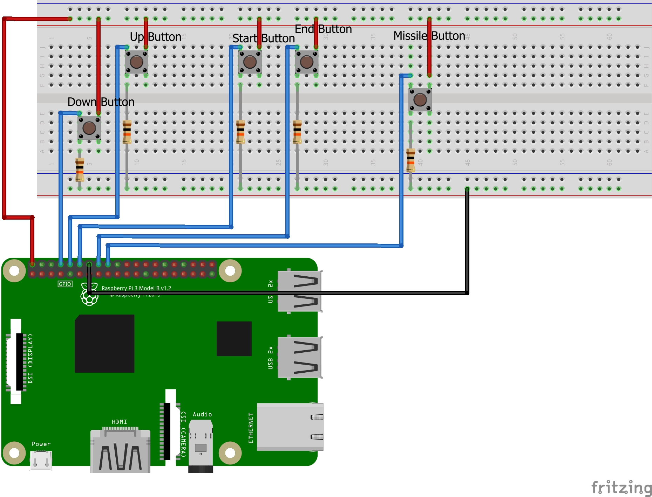
Wiring Diagram

Slide 4
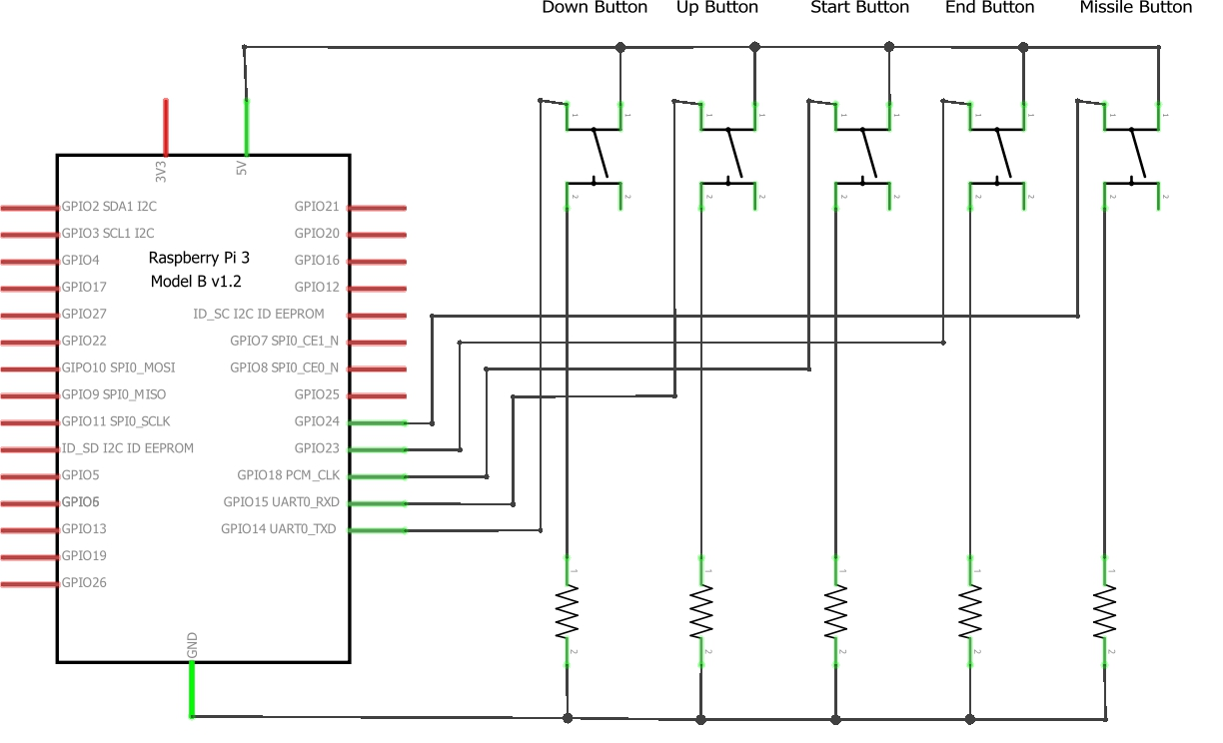
Schematic Diagram

Slide 5
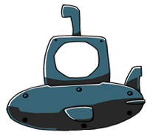
Shark Tank Game
By: Saman Sandhu
Notes:
Font: Informal Roman

Slide 6
Background
Story:
Shark Tank is a game that consists of the main player (the captain of a submarine) who is apart of a research operation where the more he explores, the more money he makes. The further he explores, the closer he gets to Antarctica, thus the captain is in more potential danger. Due to the fact that this sailor is involved in a very dangerous job, he has multiple missiles in this arsenal of equipment. In order to avoid obstacles, the captain must increase or decrease the depth of the submarine in the water. The end of the adventure is when he reaches Antarctica to give the scientists the research that he had acquired through the adventure.
Objective:
The objective of the game is to explore the subpolar water to acquire research that is to be given to the scientists already at Antarctica awaiting the captain. While acquiring the research, the captain must watch out for great white sharks and killer whales that could break the submarine in a total of three hits where the shark counts as one hit and the killer whale counts as two hits. When three hits are reached the submarine will crash and the mission will be a failure. There are 6 stages that the player must pass through in order to successfully give the scientists the acquired research.

Slide 7
Concept: Shark Tank Game
Features:
This game consists of numerous features and functions including collision detection, stages, lives, pause, score, instructions, music & image uploading, GPIO event processing, sprites, and a graphical user interface.
Limitations:
Collision detection for the game treats the shark, whale, and submarine as a rectangle, therefore if the corner of the submarine image and the obstacle image overlap, it would be counted as a collision despite no collision being seen.
The player can only fire one missile at a time, thus if more that one missile is fired at once the previous missile is removed from the screen.
When a player is first playing the game, and he/she presses instructions, they will have to wait 10 seconds before he/she can return back to the game introduction screen. This wait is quite unprofessional, and is a limitation on this game.

Slide 8
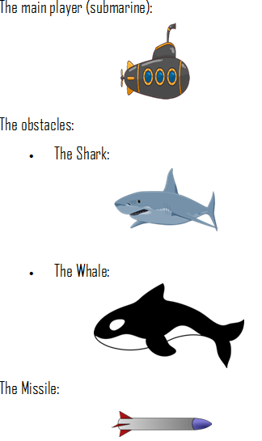
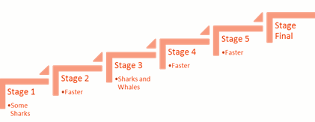
Stages
Game Images
This game will have 6 stages, beginning in the southern Atlantic Ocean, getting closer and closer to Antarctica where he will give the research to the busy scientists already working at Antarctica. Once there, the sailor will receive a cheque for all his hard work.

Slide 9
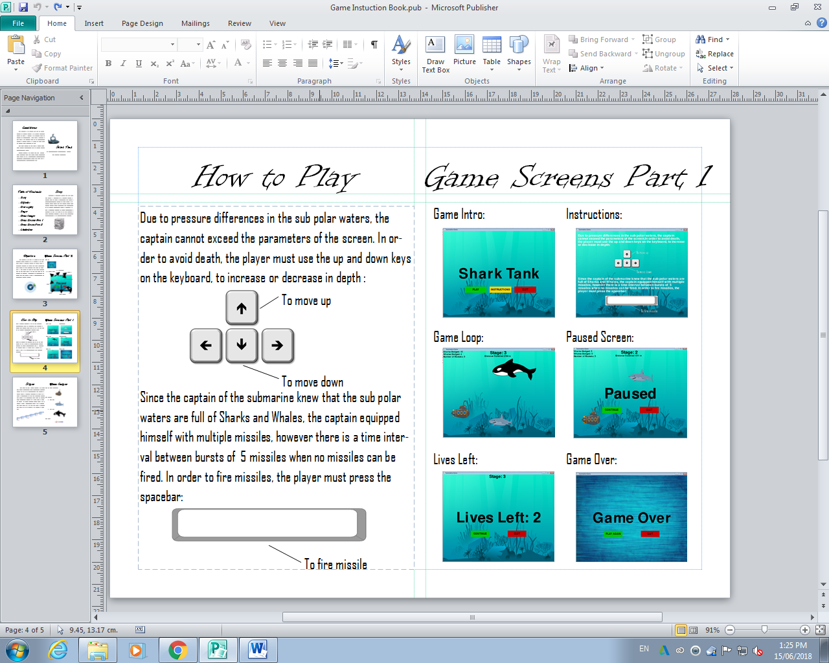
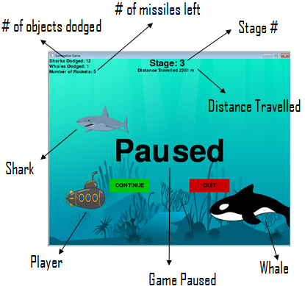
Game Screens

Slide 10
Timeline: Software Portion: The Python Game:
Task | Planned Start Date | Planned End Date | Real Start Date | Real End Date
Proof of Concept | May 9 | May 11 | May 9 | May 11
Initialize pygame | May 14 | May 14 | May 14 | May 14
Create Sprites | May 15 | May 16 | May 15 | May 16
Figure out how to render sprites | May 17 | May 19 | May 17 | May 20
Start working on game loop and move player | May 20 | May 23 | May 21 | May 24
Collision detection and crash function | May 24 | May 26 | May 25 | May 28
Score Display Functions | May 27 | May 29 | May 29 | May 30
Pause Functions | May 30 | May 31 | May 31 | June 1
Game intro function | June 1 | June 3 | June 2 | June 3
Convert program to support sprite lists | June 4 | June 6 | June 4 | June 8
Make rockets work | June 7 | June 9 | June 9 | June 10
Add Stages | June 10 | June 12 | June 11 | June 12
Add Lives function (so player has 3 lives) | June 13 | June 15 | June 13 | June 14

Slide 11
Timeline: The Hardware Portion: Raspberry Pi:
Task | Planned Start Date | Planned End Date | Real Start Date | Real End Date
Proof of Concept | May 9 | May 11 | May 9 | May 11
Install SD Card Formatter and format it | May 14 | May 14 | May 14 | May 14
Install Raspbian on SD Card | May 15 | May 15 | May 15 | May 15
Make a button and led circuit work | May 16 | May 22 | May 16 | June 10
Hook up the circuit | May 16 | May 17 | May 16 | May 17
Write Program | May 18 | May 19 | May 18 | May 19
Troubleshoot | May 20 | May 22 | May 20 | June 10
Add the rest of the buttons | May 23 | May 25 | June 11 | June 12
Put the two programs together | June 15 | June 18 | June 13 | June 15

Slide 12
Learning Paragraph
Throughout this project I gained and improved on numerous skills through the usage of the raspberry pi whether that was the electronic or programming aspect. Electronically, I connected and tested button and led circuits using the GPIO module. Moreover, I used a procedural programming language, python, to apply fundamental programming concepts to develop a complex program that controls an external device using inter-device communication.
I encountered some issues, most of which were easily fixed, though it was sometimes difficult to identify what the problem was. One of these issues were that I was unable to render rockets for a large period of time, until I changed my approach and started using sprite lists (“pygame.sprite.Group()”). When I began to use sprites lists, my problem was still unsolved so I decided to start all over again, and then just add all my other functions into my new program later. Eventually, I got it to work. Despite the time working to try to get the rockets to work, it was still worthwhile, because I learned a lot about different ways for rendering sprites in pygame.
Overall, after all the struggles that I encountered during this project, it has taught me that all you really have to do to be successful in programming, electronics or life in general is never give up, because eventually I got my game to work mostly the way I wanted it to work.

Slide 13
Words of Wisdom
Instruction List:
Upload raspbian onto formatted SD card.
Setup a 5-button circuit.
Create sprites and general game loop using python.
Use the button state inputs for player movement.
Add game features including, collision detection, pausing, and missiles.
Use the button state inputs for the above features.
Add any more features that make a game a game (eg. game intro, score, stages, and lives).
Need to Know:
Make sure you format the SD card before you upload raspbian on it.
Don’t pull the SD card out without shutting the raspberry pi down or ejecting it.
If the raspberry pi is stopping at the start screen, the SD card could be corrupted, so try re-uploading raspbian after formatting the card again.
Use a header on the raspberry pi pins the ensure a proper connection is made throughout the circuit.
Avoid short circuiting the raspberry pi as much as possible or else it will keep shutting down (try using resistors).
The raspberry pi 3 is more suitable for the purpose of a more complex program (eg. a game) due to it having greater processing power than the raspberry pi zero, but despite that, the user may still experience large delays.
Use a try and except statement to ensure that the GPIO pins are cleaned up before the program is killed.

